Slide 1






CHAPTER 3. Concurrency, CPU Bound vs I/O Bound
동시성과 병렬성 배우기
Blocking vs Non-Blocking IO
고수가 되는 파이썬
좋은사람

Slide 2







CHAPTER 3. Concurrency, CPU Bound vs I/O Bound
오늘 배울 내용
Blocking
Non-Blocking
Synchronous vs Asynchronous

Slide 3
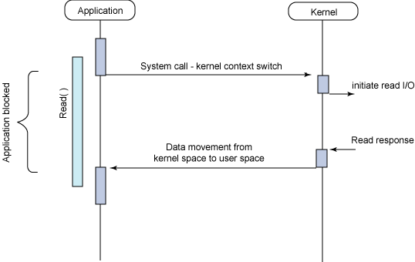
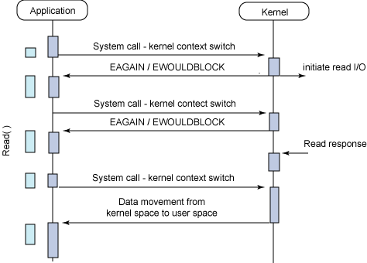
Sync blocking IO
Sync non-blocking IO
https://developer.ibm.com/articles/l-async/

Slide 4
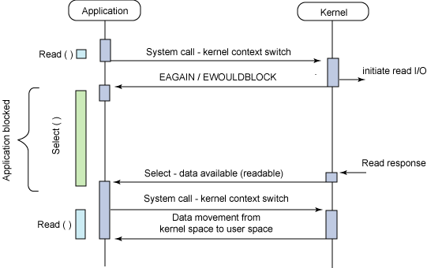
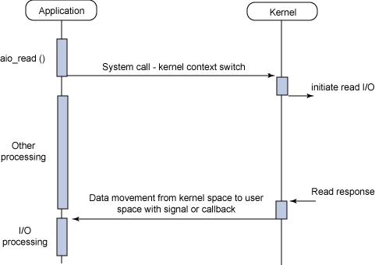
Async blocking IO
Async non-blocking IO
https://developer.ibm.com/articles/l-async/

Slide 5
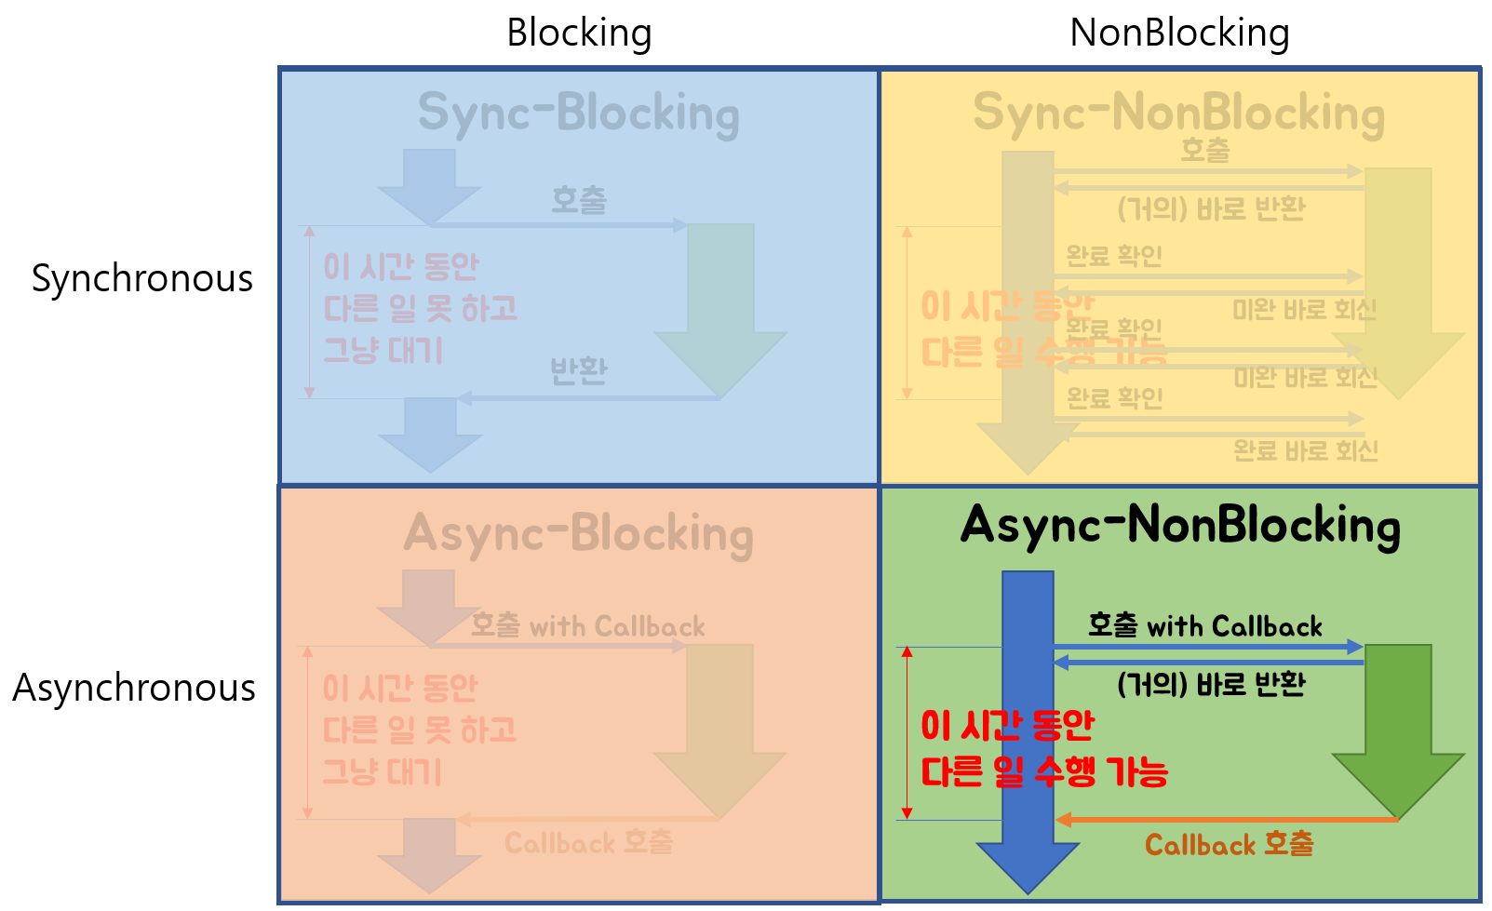
https://limdongjin.github.io/concepts/blocking-non-blocking-io.html#운영체제-교재에-기반한-분류

Slide 6

CHAPTER 3. Concurrency, CPU Bound vs I/O Bound
감사합니다

